Slide 1



PROGRAMMING FUNDAMENTALS IN C
Problem Solving in C

Slide 2
Motivation
Write a C program to output “Welcome To C course, <YOUR NAME>”
Use CMD and notepad ONLY.
#include <stdio.h>
int main()
{
printf("%s\n","Welcome to C course, Omar");
return 0;
}

Slide 3
Motivation
Write a C program to output “Welcome To C course, <YOUR NAME>”
Save the file as “welcome.c”
Open cmd in the folder contains code
Write “gcc welcome.c”
Run the output exe file, “a.exe”
#include <stdio.h>
int main()
{
printf("%s\n","Welcome to C course, Omar");
return 0;
}

Slide 4

Motivation
Write a C program to output “Welcome To C course, <YOUR NAME>”
Save the file as “welcome.c”
Open cmd in the folder contains code
Write “gcc welcome.c”
Run the output exe file, “a.exe”
#include <stdio.h>
int main()
{
printf("%s\n","Welcome to C course, Omar");
return 0;
}
You can use visual studio compiler from cmd
Open developer command prompt
Compile the file using $cl <FILENAME.c>$
Run the file using <FILENAME.exe> https://docs.microsoft.com/en-us/cpp/build/walkthrough-compile-a-c-program-on-the-command-line?redirectedfrom=MSDN&view=msvc-160

Slide 5
Objectives
Write Simple C programs
Comments
Understanding basic data types in C
Use arithmetic operators
Understand the precedence of C operators

Slide 6
Introduction to C Programming
The structure of a basic C program
Data types and keywords
Mathematical Operations in C

Slide 7

The structure of a basic C program
$\#include<stdio.h>$
$\#include$: this called preprocessor directive
$stdio.h$: is a header file contains $printf()$ function and other IO functions
Get the file called $stdio.h$ to use the functions inside it
#include <stdio.h>
int main()
{
printf("%s\n","Welcome to C course, Omar");
return 0;
}

Slide 8

The structure of a basic C program
$int main()$
$int$: a data type identifies the function will return an INTEGER value
$main$: function name, it’s the entry point to every C program
$()$: parenthesis to pass parameters to a function
$\{$: curly brackets indicates the start of function body
#include <stdio.h>
int main()
{
printf("%s\n","Welcome to C course, Omar");
return 0;
}

Slide 9

The structure of a basic C program
$printf\left("\text{\%}\text{s}\text{\backslash }\text{n}\text{"},\text{"}\text{Welcome} \text{to} \text{C} \text{course}\text{, }\text{Omar}\text{"}\right);$
$printf()$: a function the prints the data between () to the console screen
$"\%s\backslash n“$: control parameter, indicates the function prints a string
A string is a sequence of characters, symbols and digits
%s = refers to string
\n = print new line
Any string after “,” is printed as it is
The $;$ indicates the end of a statement
#include <stdio.h>
int main()
{
printf("%s\n","Welcome to C course, Omar");
return 0;
}

Slide 10

The structure of a basic C program
$return 0;$
$return$: is a keyword indicates that a function will return a value – 0
$\}$: is the end of the function body
#include <stdio.h>
int main()
{
printf("%s\n","Welcome to C course, Omar");
return 0;
}

Slide 11

The structure of a basic C program
Notes about the code:
Almost every statement in C is terminated by ;
The control parameter $"\%s\backslash n“$ is not displayed on a screen.
Any thing between “ “ is printed as it is
The $return$ keyword is the last statement executed in the function block
You can write multiple statements in one line separated by a ;
#include <stdio.h>
int main()
{
printf("%s\n","Welcome to C course, Omar");
return 0;
}

Slide 12
Detect the variations
Different code, same result
#include <stdio.h>
int main()
{
printf("%s\n","Welcome to C course, Omar");
return 0;
}
#include <stdio.h>
int main( void )
{
printf( "Welcome to C course, Omar\n" );
}
#include <stdio.h>
void main()
{
printf( "Welcome to C course, Omar\n" );
}
#include <stdio.h>
void main()
{
printf( "Welcome to C course" );
printf(", Omar\n");
}

Slide 13
The structure of a basic C program
Comments
Comments are a way to document your code
Describes the meaning of a code
Write //<YOUR COMMENT> in one line
Write /* <YOUR COMMENT>*/ in multi-lines
Comments are ignored by compiler
//this is pre-processor to include stdio header file
#include <stdio.h>
//this is the program entry point, main function
int main()
{
printf("%s\n","Welcome to C course, Omar"); //print to the console
return 0; // return 0, an integer value
}
//The end of your program

Slide 14

The structure of a basic C program
Escape sequences
$\backslash n$ = new line
$\backslash t$ = new tab (8 spaces)
$\backslash \backslash$ = prints one \
\” = prints “

Slide 15
Exercise 01
Write a program that prints:
This is my first “C” program \**/
#include <stdio.h>
int main()
{
printf("This\t is my first \"C\" program\n");
printf("\\**/\n");
return 0;
}

Slide 16
Introduction to C Programming
The structure of a basic C program
Data types and keywords
Mathematical Operations in C
I/O in C
Exercises: Pseudocode, Flow chart, Code

Slide 17
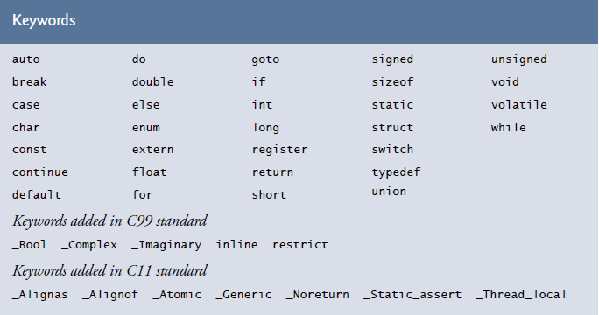
Data types and keywords
Keywords are predefined, reserved words used in programming that have special meanings to the compiler.
Part of the syntax and they cannot be used as an identifier.

Slide 18
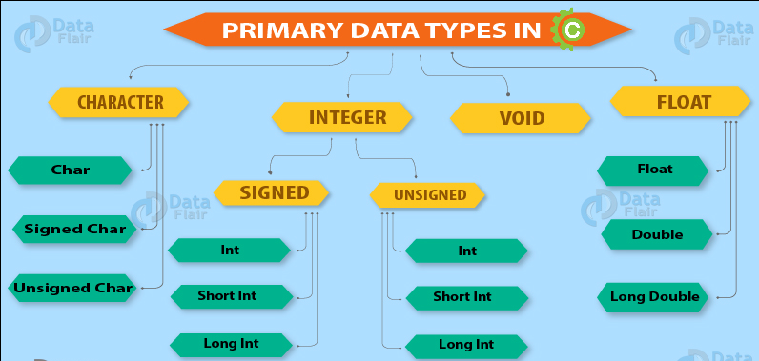
Data types and keywords
Data type is a keyword used for declaring variables or functions.
Each data type has its storage size

Slide 19
Data types and keywords
Data Types | Memory Size | Range
char | 1 byte | −128 to 127
signed char | 1 byte | −128 to 127
unsigned char | 1 byte | 0 to 255
short | 2 byte | −32,768 to 32,767
signed short | 2 byte | −32,768 to 32,767
unsigned short | 2 byte | 0 to 65,535
int | 2 byte | −32,768 to 32,767
signed int | 2 byte | −32,768 to 32,767
unsigned int | 2 byte | 0 to 65,535
Data Types | Memory Size | Range
short int | 2 byte | −32,768 to 32,767
signed short int | 2 byte | −32,768 to 32,767
unsigned short int | 2 byte | 0 to 65,535
long int | 4 byte | -2,147,483,648 to 2,147,483,647
signed long int | 4 byte | -2,147,483,648 to 2,147,483,647
unsigned long int | 4 byte | 0 to 4,294,967,295
float | 4 byte
double | 8 byte
long double | 10 byte

Slide 20
Data types and keywords
Let’s test the data types in code
#include <stdio.h>
int main() {
short a;
int b;
long c;
double d;
printf("size of short = %d bytes\n", sizeof(a));
printf("size of int = %d bytes\n", sizeof(b));
printf("size of long = %d bytes\n", sizeof(c));
printf("size of float = %d bytes\n", sizeof(d));
return 0;
}

Slide 21

Exercise 02
Try other data types: $float, long double, char$
#include <stdio.h>
int main()
{
char a;
long double b;
float c;
printf("size of char = %d bytes\n", sizeof(a));
printf("size of long double = %d bytes\n", sizeof(b));
printf("size of float = %d bytes\n", sizeof(c));
return 0;
}

